Slide 1


Hugs
Hug Someone
Discovery Board

Slide 2


Benefits of hugging
Effects of a hug
When they are needed
Sound of a hug
Hugging techniques
Click on each link on a finger to navigate to that page

Slide 3
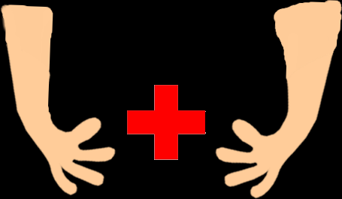
Benefits of Hugging
Giving and receiving hugs, are known to release the chemical oxytocin which induces pleasure and happiness.
Hugs are excellent stress relievers
It is shown that people who hug regularly have a less chance of contracting heart disease
Hugs are free, usually.
Home

Slide 4


Hugging Techniques
Home

Slide 5
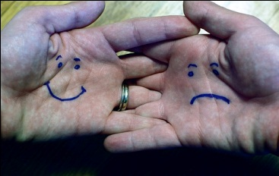

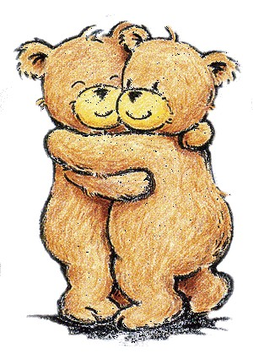
Effects of a Hug
Here are the effects of a Hug on someone who is in a bad mood, and needs some love!
Click Here
Home
Hugs

Slide 6
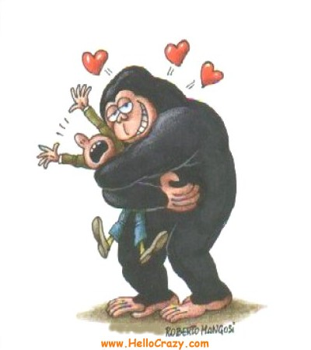
When they are needed
If someone has had an argument a hug can help them to get over things and feel better.
If a loved one has passed away and someone who loved them was mourning a hug will help them to move on and look forward to their future.
When you celebrate anything a hug reinforces the good feelings and will lift up your spirits even more.
Couples should never stop hugging each other because a nice hug shows you still care..
Home

Slide 7



Sounds of a Hug
Here are the sounds of some hugs in action
Hug sound- Human
Hug sound- Pig
The mind during a hug
Home
Click to hear

